Slide 1
Welcome Back!
Mrs. Henry
English 10: Honors

Slide 2
Coursework
Theme-Based Syllabus (online)
Major Works:
Lord of the Flies
Julius Caesar
Paradise Lost
Things Fall Apart
Antigone
Fahrenheit 451
Heart of Darkness

Slide 3
Coursework
Also Covered: Assorted short stories, poems, essays, articles, etc..
Writing Concentration
MCAS
Vocabulary

Slide 4
Grading
Essays/Tests: 40%
Literature Quizzes: 30%
Participation: 10%
Classwork/Homework: 10%
Vocabulary Quizzes: 10%

Slide 5
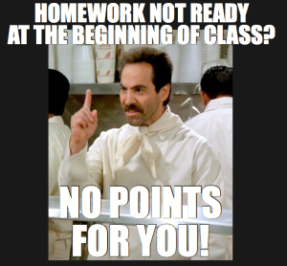
Homework
Mostly ungraded reading, corresponding writing assignments, reading checks and active reading (annotations)
A.R:
Plot,
Character development,
Theme development,
Symbol tracking,
Questions,
New vocab,
Other

Slide 6
Absences/Make-up Work
Missed assignments = your responsibility.
Includes: quizzes, tests, homework, classwork
Ask at appropriate times (break, end)
Per school rules, you have two days to make up missed work. I will allow one week.

Slide 7
Essays
One essay per novel
Deadlines:
There is a letter grade deduction for every DAY that an essay/project is late, EVEN IF OUR CLASS DOES NOT MEET THAT DAY.
If you have special circumstances, see me.

Slide 8
Essays: One Day Policy
Question regarding a piece of graded writing?
Please wait 24 hours to discuss it with me.
This will give you a chance to review your work and focus your questions.

Slide 9
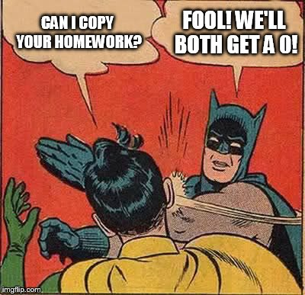
Plagiarism
According to the school handbook, plagiarism will be handled as followed:
Egregious and Purposeful Plagiarism:
Using a friend’s paper,
using a paper from the internet,
copying and pasting sections
from an original text and passing
them off as your own.
Will receive a 0 with no
chance of rewriting.

Slide 10
Plagiarism
Inadvertent/Accidental Plagiarism: Putting quotes around something but not providing parenthetical citation or a works cited, trying to paraphrase but copying the language too closely. Will receive a 64. Rewrite opportunities will be handled on a case to case basis.

Slide 11
Participation
Being active in class discussion
Completion of required and graded elements.
Entertain and offer new and contrary ideas
Put forth your best effort
Advocate for yourself and use extra help sessions

Slide 12
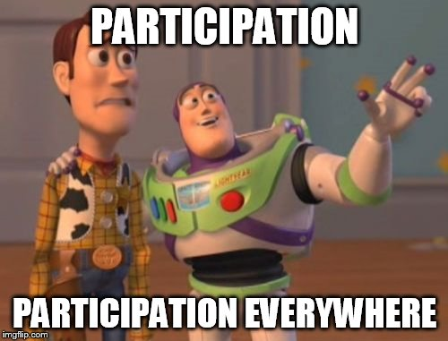

Slide 13
Classroom Procedures
When the bell rings, sit down, quiet down.
Take out your materials (charge that IPad!)
Bathroom sign out sheet at front of room.
Help yourself to tissues, tape, hole punch, etc…

Slide 14
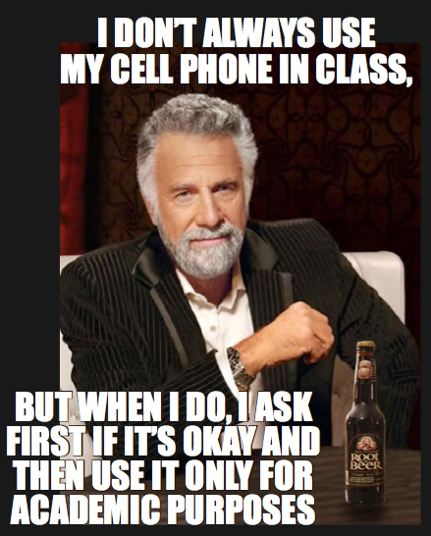
Classroom Procedures
Extra books in closet
Don’t line up at door
Cell phone use-
only appropriate times

Slide 15
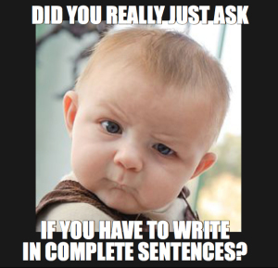
Classroom Procedures
To ensure a response, email correspondence must contain:
-Subject line
-Greeting
-Appropriate tone
- Signature

